Slide 1
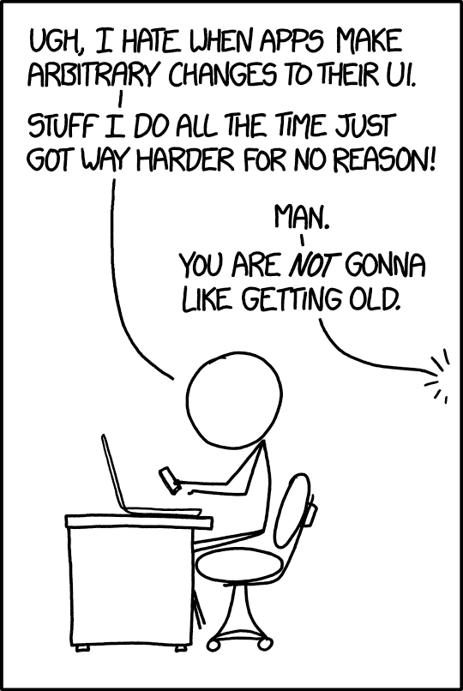
Give them a GUI with tkinter & ttk

Slide 2
tkinter and ttk: What & Why
A cross-platform UI tool kit. Users on Mac and/or Windows and/or Linux will get native looking apps with little to no customization required
tkinter is simply the python interface to Tcl/Tk
ttk (themed tool kit) extends tkinter with additional widgets and more modern UI themes (Windows 10, OSX, etc)

Slide 3
Why tkinter & ttk
tkinter is included in the standard library, no additional dependencies, installations, or stacks to manage
It’s fairly high level, making it easy to plan and design before writing any code.

Slide 4
First code!
Verify it’s availability with:
>> import tkinter
>> tkinter._test()

